Slide 1
The Entrepreneurial Network of College of Management Sciences
Student’s Startups
COHORT 1

Slide 2
Upni market is an online and SAAS marketplace that bridges the gap between customers, service providers, and sellers. Envisioning to help small businesses grow so they can help the unemployed people by hiring them by Multirestaurant/store/services/Need's online ordering & Delivery solution through our progressive web apps
Ahsan Zahid
Founder: Upni Market

Slide 3
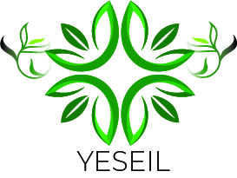
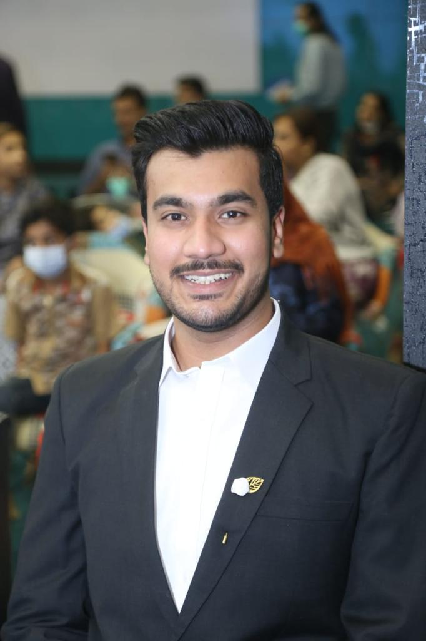
Yeseil is a small business that makes handmade soaps with organic oils and plant butters, pure essential oils, organic herbs, and spices. Our moisturizing organic natural soap recipes are meticulously developed to produce a mild, skin- nourishing soap that offers a magnificent long-lasting lather and leaves your skin feeling clean, soft and radiantly healthy. People nowadays have become more aware of the hazards of using chemical loaded products.
Muhammad Asadullah
Founder: Yeseil

Slide 4
Our idea is to maintain a sustainable cycle of empowering the unemployed by providing bikes on instalments and the generated revenue from instalments will be reinvested into the social enterprise "Togetherley"
Mudassir Zafar Iqbal
Founder: Togetherley

Slide 5
Rise Up Homeschool provides a Cambridge-based curriculum and routinely trains online parents about to implement the curriculum from pre-school to grade 8 children. We break down the curriculum into weekly segments, and set up online meeting with parents to guide them to educate them creatively and effectively. This is done on weekly basis, step by step that would easily manageable for both parents and children.
Sana Khan
Founder: Rise up Home School

Slide 6
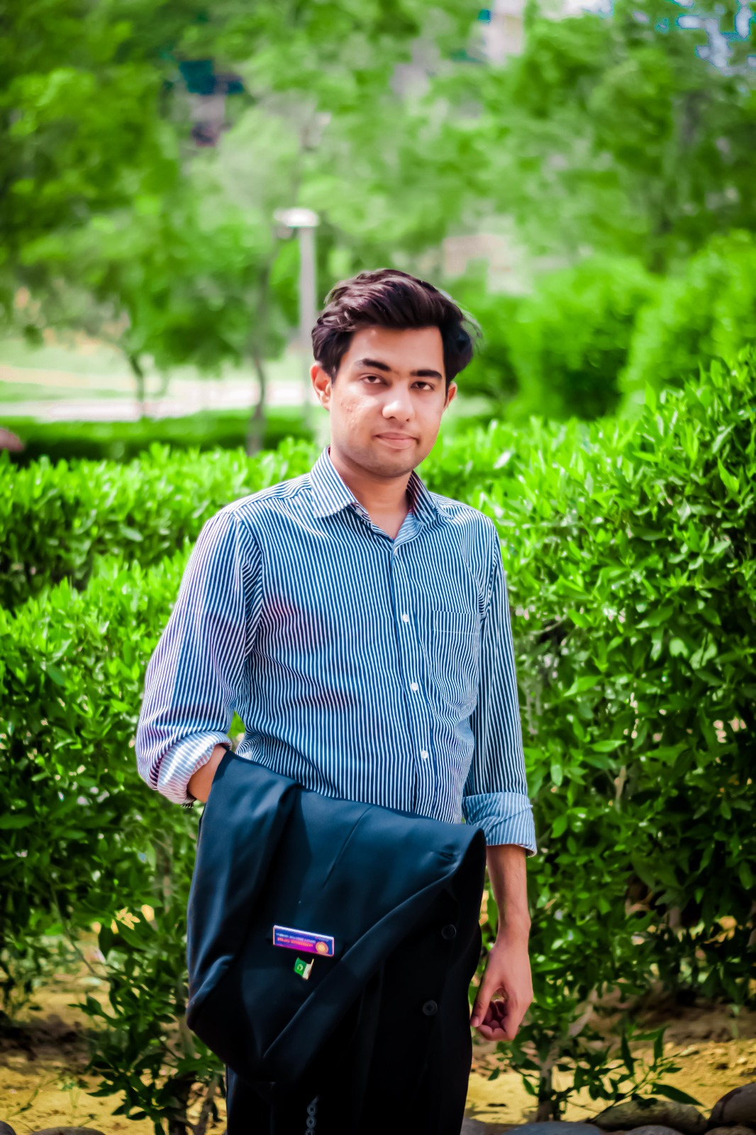
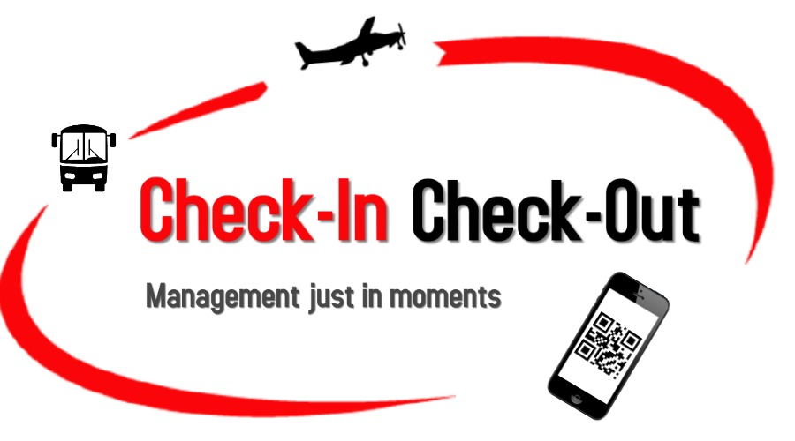
Automated system, where Record management, check in check out and ticketing process will accomplish in cost and time effective way with secure cloud encrypted interface.
Muhammad Tayyab
Founder: Check In

Slide 7
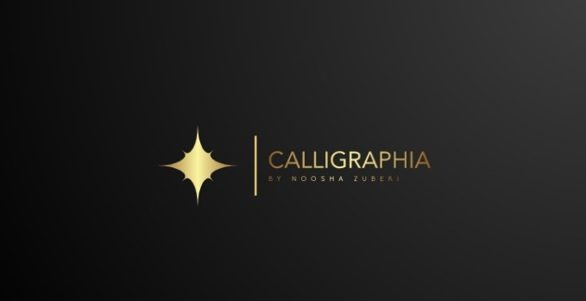
Calligraphia deals with 100% handmade Arabic calligraphy without the use of stencils. We make sure that the calligraphy you receive from us is packed properly and it is 100% legit without any mistakes. And to make that sure, we send a verified certificate by a Islamic scholar who verifies each and every single piece. Along with that, we also send a certificate of authenticity for every art piece. This is why this is the best place to buy authentic Arabic calligraphy in Pakistan and throughout the world.
Noosha Zuberi
Founder: Calligraphia

